Slide 1
Sent by the Ancestors Women, HIV & Islam
by
Christopher A. Brooks
with translations by
Salim Coumare
© Christopher A. Brooks 2016. All rights reserved.

Slide 2
Through the Voices of Men

Slide 3
Why Mali and why women?

Slide 4
HIV in Africa (Brooks 2011)

Slide 5
Citations
Steuer, Noemi. “’We are just afraid of what others may say about us.’ Maintaining honour and respect in processes of disclosure in Bamako, Mali.” MAT: Medicine Anthropology Theory. (September 2012): n. pag. Web. October 5, 2015.
Pagezy, Helen, and Le Palec, Annie. Vivre avec le VIH au Mali. Stratégies de survie, Paris, L’Harmattan, 271 p., (2003). Put online July 10, 2009, accessed October 5, 2015.
“In Mali, HIV/AIDS remains shrouded in silence.” Mali. UNICEF. March 13, 2014. Date Accessed: October 12, 2015
Hasnain, Memoona. “Cultural Approach to HIV/AIDS Harm Reduction in Muslim Countries.” Harm Reduction Journal 2 (2005): 23. PMC. Web. Date Accessed: October 12, 2015.
Gray, Peter B.“HIV and Islam: is HIV prevalence lower among Muslims?” Social Science & Medicine (2003). Elsevier. Date Accessed: October 14, 2015.

Slide 6
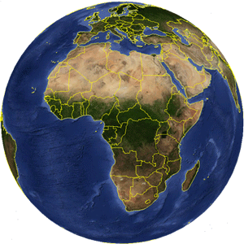
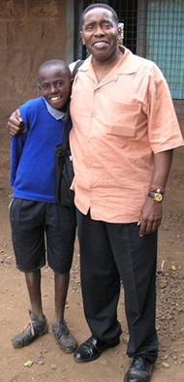
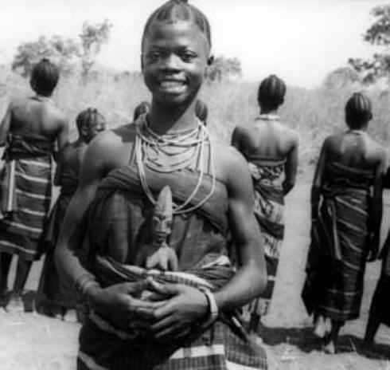
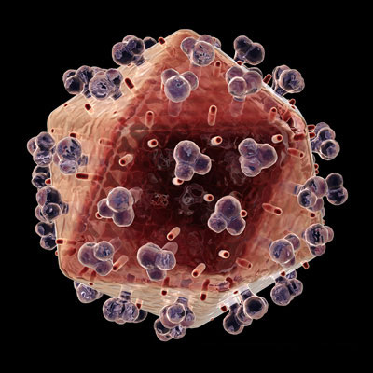
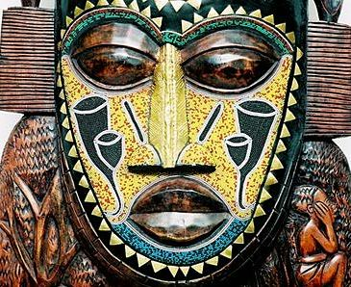
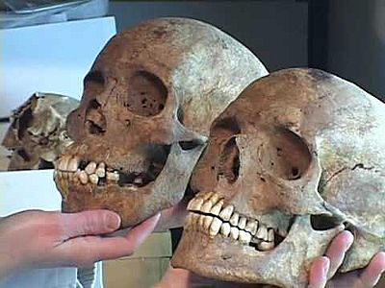
An Africanist Anthropologist & HIV

Slide 7
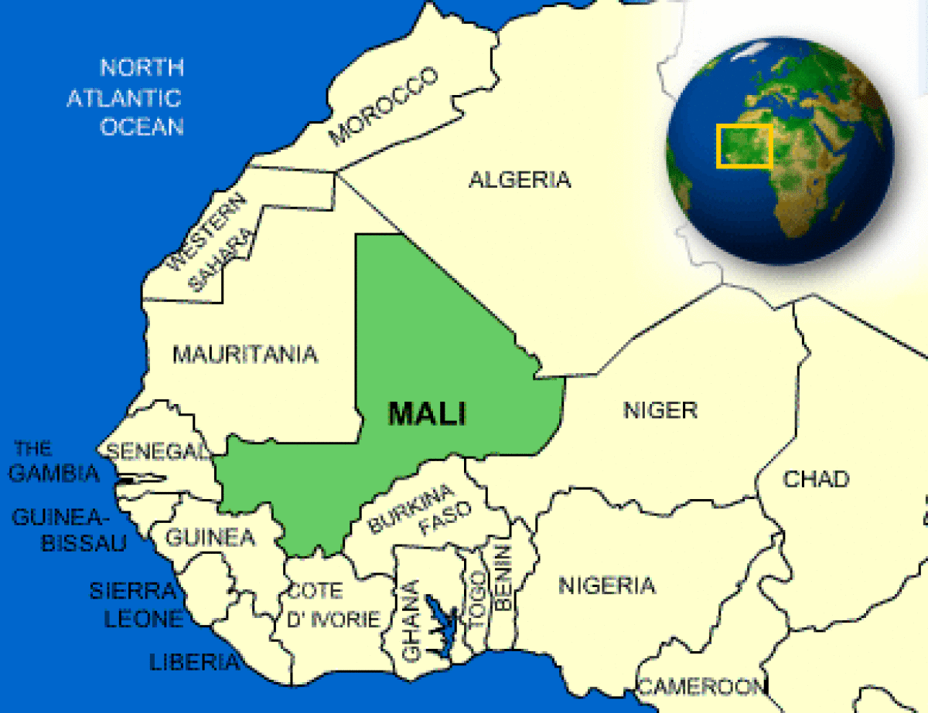
Mali

Slide 10
Malinké

Slide 11
Bamana

Slide 12
Khassonké

Slide 13
Sarakollé or Soninké

Slide 14
Bobo

Slide 15
Les Peuls ou Fulani

Slide 16
Dogon

Slide 17
Minianka

Slide 18
Sénoufo

Slide 19
Bozo/Somono

Slide 20
Toucouleur

Slide 21
Sonrhai (Songhai)

Slide 22
Tuareg

Slide 23
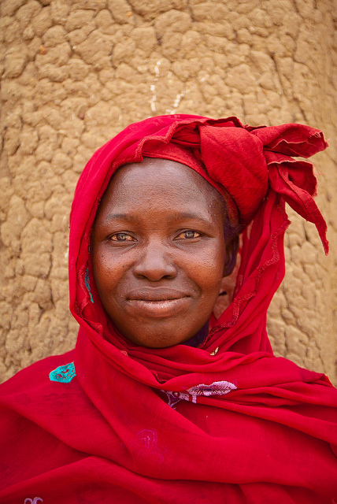
Ethnic groups in Sent by the Ancestors
Bamana

Slide 24
Bobo

Slide 25
Dogon

Slide 26
Fulani

Slide 27
Malinke

Slide 28
Minianka

Slide 29
Peul

Slide 30
Samogo

Slide 31
Sarakole

Slide 32
Senufo

Slide 33
Somono (Bozo)

Slide 34
Soninke

Slide 35
Tuareg

Slide 36
The Trans-African Highway trucking routes

Slide 37
Malian Army

Slide 38
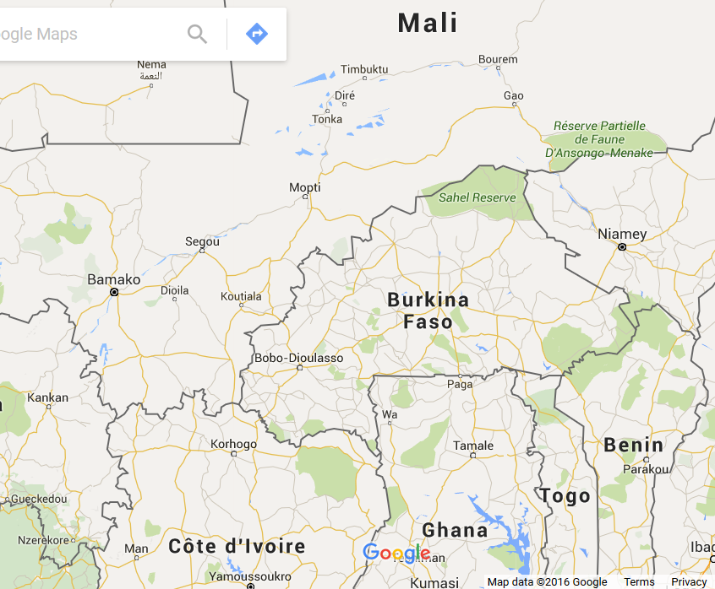

Slide 39
Gold mines in Mali

Slide 40
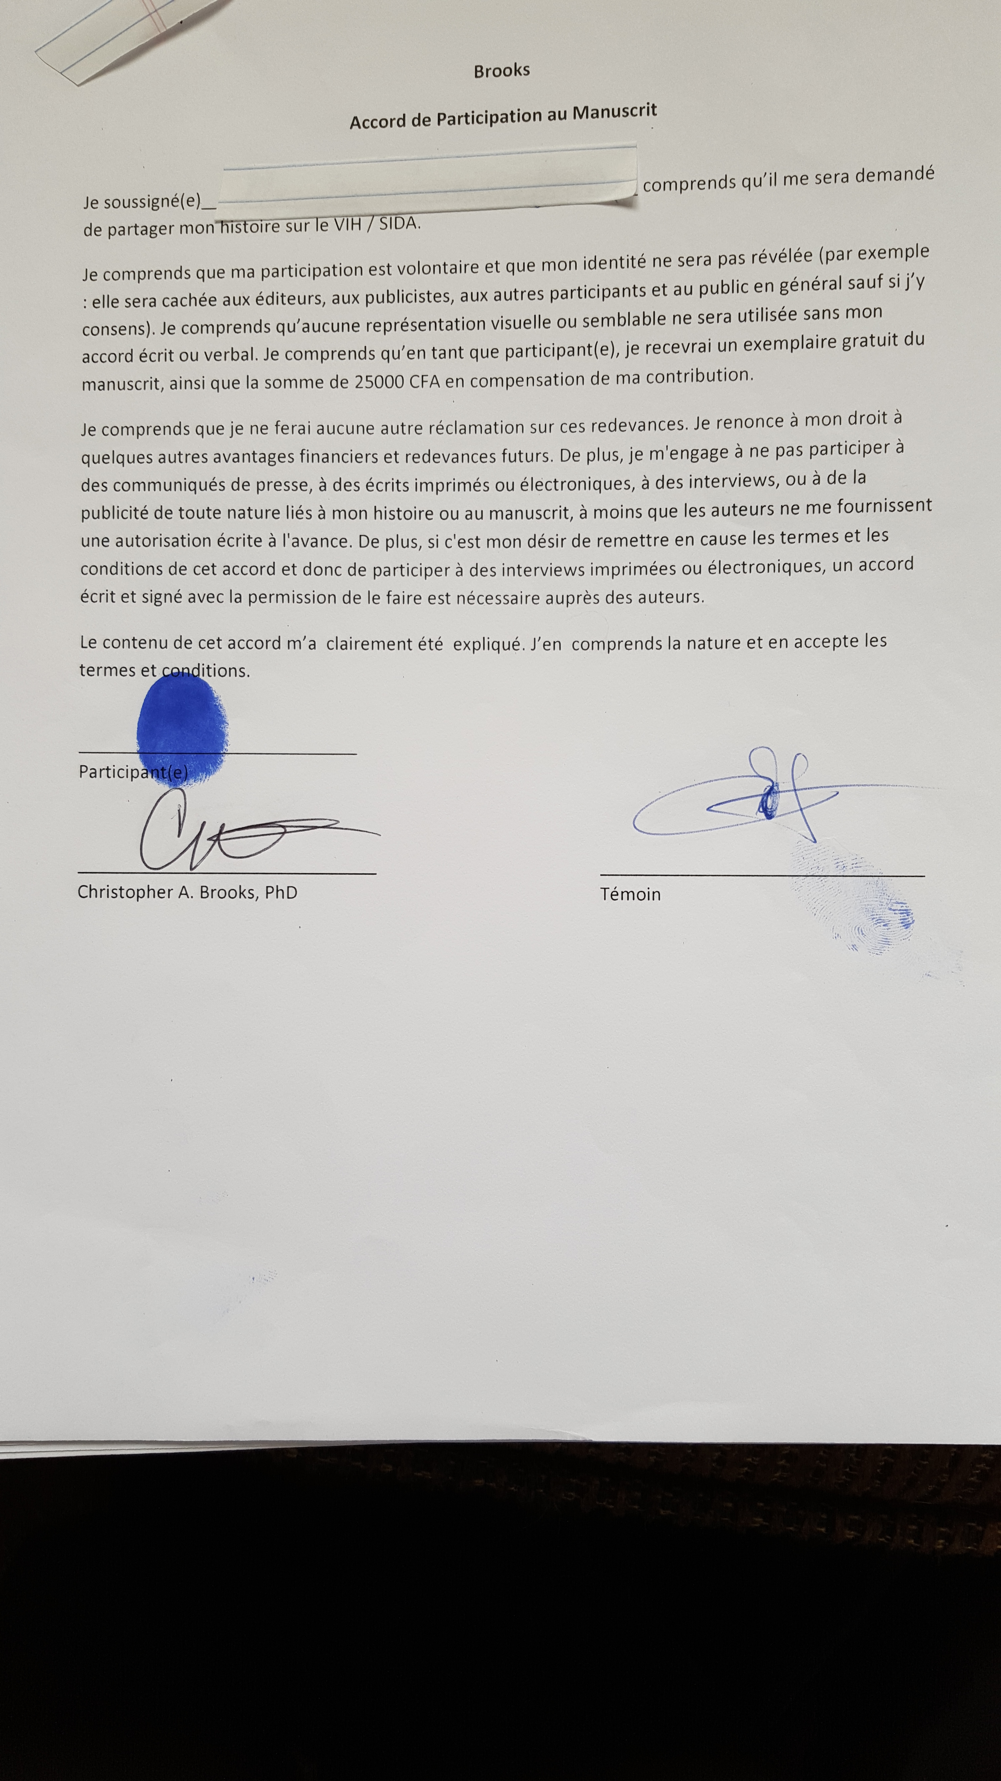
Brooks consent form

Slide 41
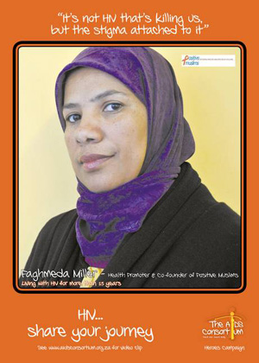
Positive Muslims In South Africa

Slide 42
Traditional Healers in Mali

Slide 43
Marietou Dembele

Slide 44
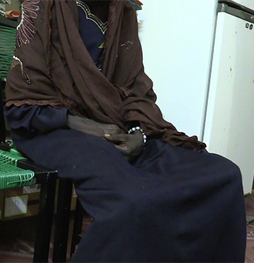
Oumou Ouattara

Slide 45
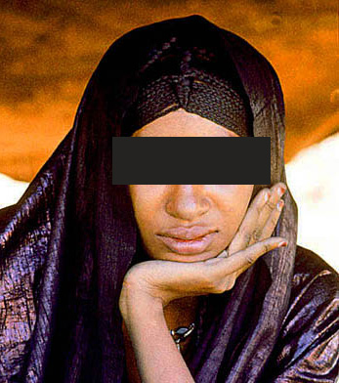
Fatimata Musa

Slide 47
Acknowledgements
Bill and Melinda Gates Foundation
US Department of Education Title VII
VCU Anthropology
VCU Humanities Center
College of Humanities and Sciences
VCU Women’s Health Institute,
VCU HIV/AIDS Center
Virginia Friends of Mali
City of Segou
Charlotte Russell, Intern
HIV in Africa course members
David G. Kimani - Presentation

Slide 48
The End
Thank you!!

