Slide 1

The Most Vulnerable
Women, HIV and Islam in Mali
by
Christopher A. Brooks
with translations by
Salim Coumare
© Christopher A. Brooks 2016. All rights reserved.

Slide 2

Through the Voices of Men

Slide 3
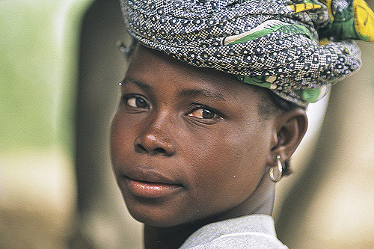
Why Mali and why women?

Slide 4
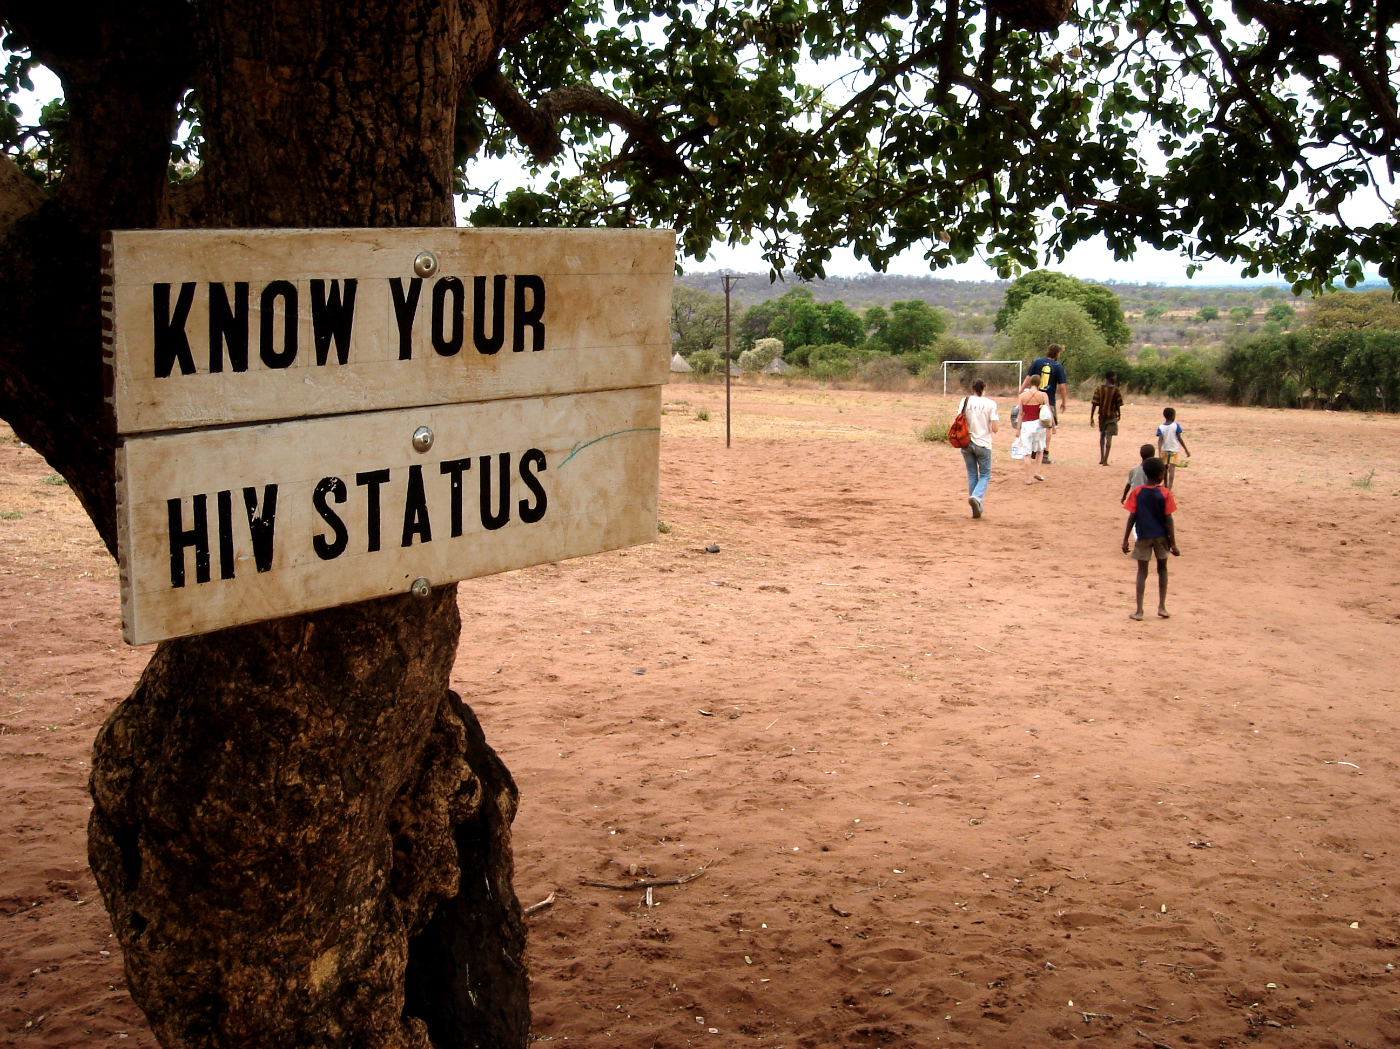
HIV in Africa (Brooks 2011)

Slide 5
Citations
Steuer, Noemi. “’We are just afraid of what others may say about us.’ Maintaining honour and respect in processes of disclosure in Bamako, Mali.” MAT: Medicine Anthropology Theory. (September 2012): n. pag. Web. October 5, 2015.
Pagezy, Helen, and Le Palec, Annie. Vivre avec le VIH au Mali. Stratégies de survie, Paris, L’Harmattan, 271 p., (2003). Put online July 10, 2009, accessed October 5, 2015.
“In Mali, HIV/AIDS remains shrouded in silence.” Mali. UNICEF. March 13, 2014. Date Accessed: October 12, 2015
Hasnain, Memoona. “Cultural Approach to HIV/AIDS Harm Reduction in Muslim Countries.” Harm Reduction Journal 2 (2005): 23. PMC. Web. Date Accessed: October 12, 2015.
Gray, Peter B.“HIV and Islam: is HIV prevalence lower among Muslims?” Social Science & Medicine (2003). Elsevier. Date Accessed: October 14, 2015.

Slide 6
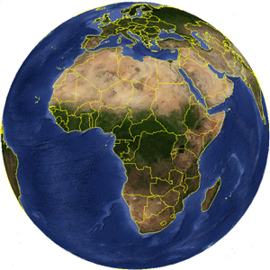
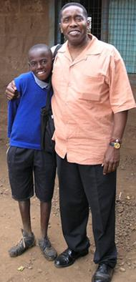
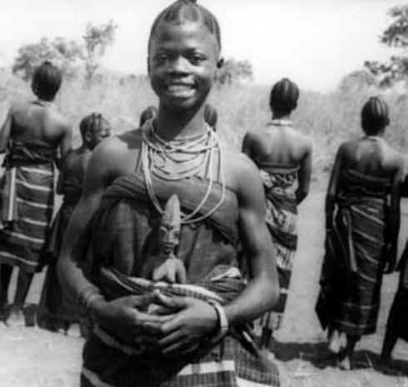
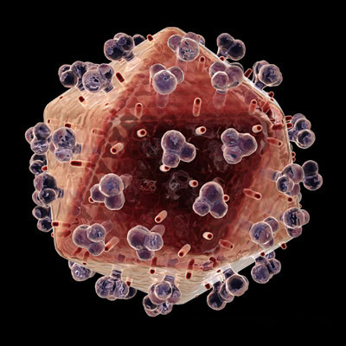
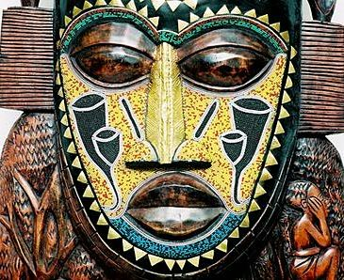
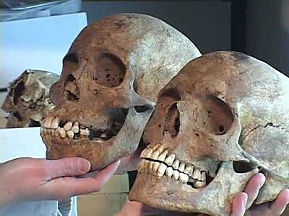
An Africanist Anthropologist & HIV

Slide 7
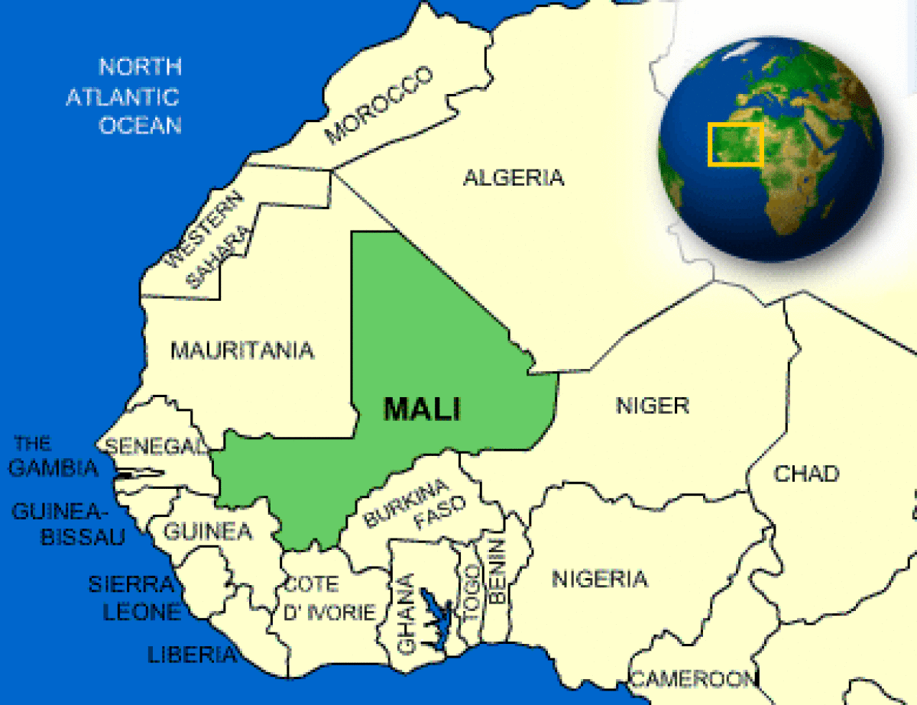
Mali

Slide 8
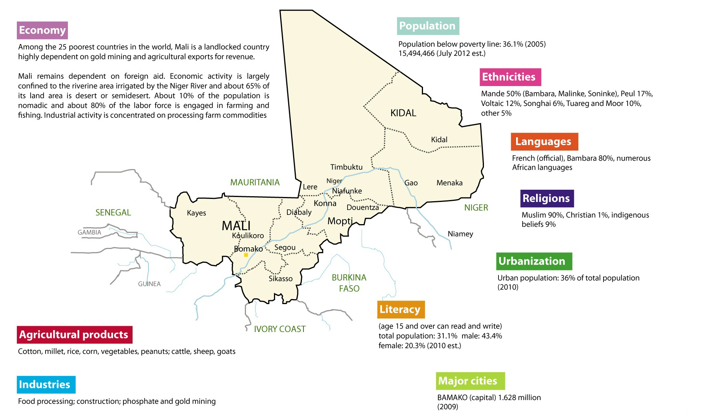

Slide 9
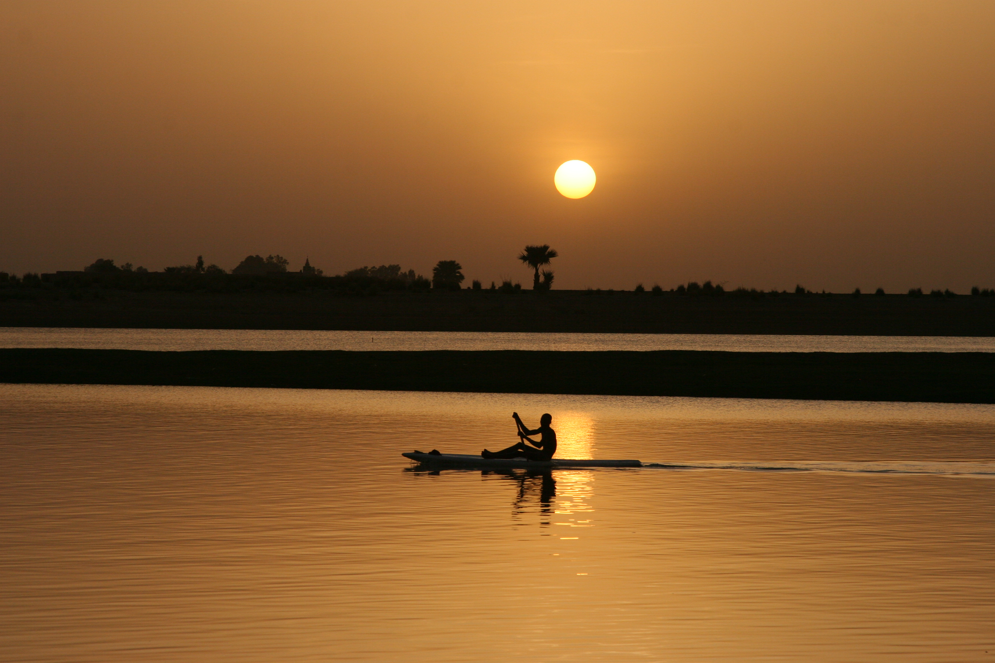

Slide 10
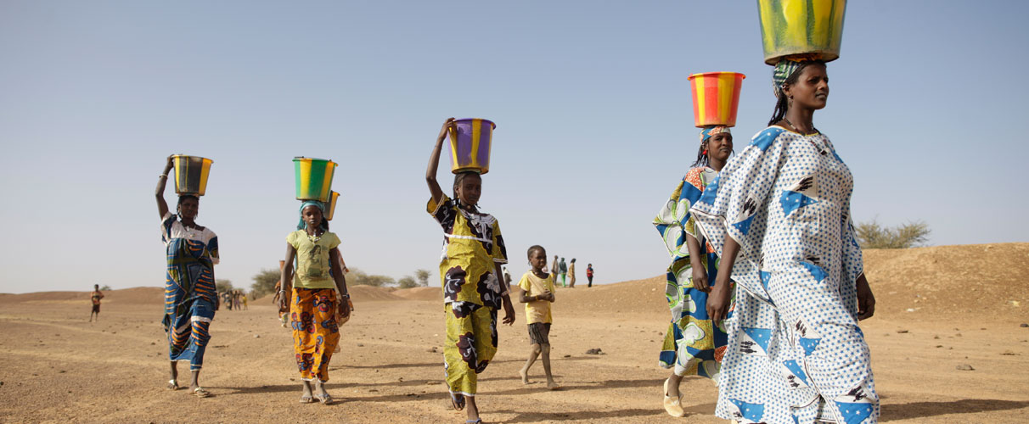
Malinké

Slide 11
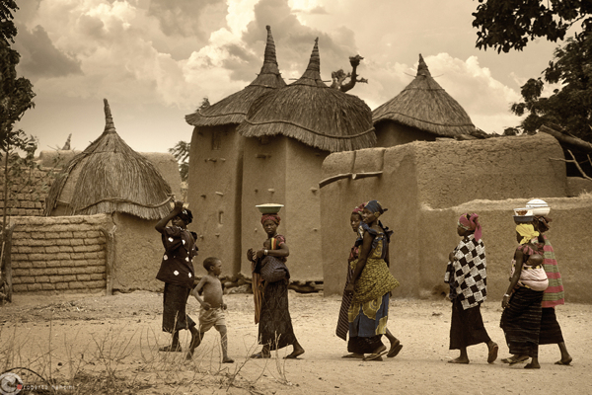
Bambera

Slide 12
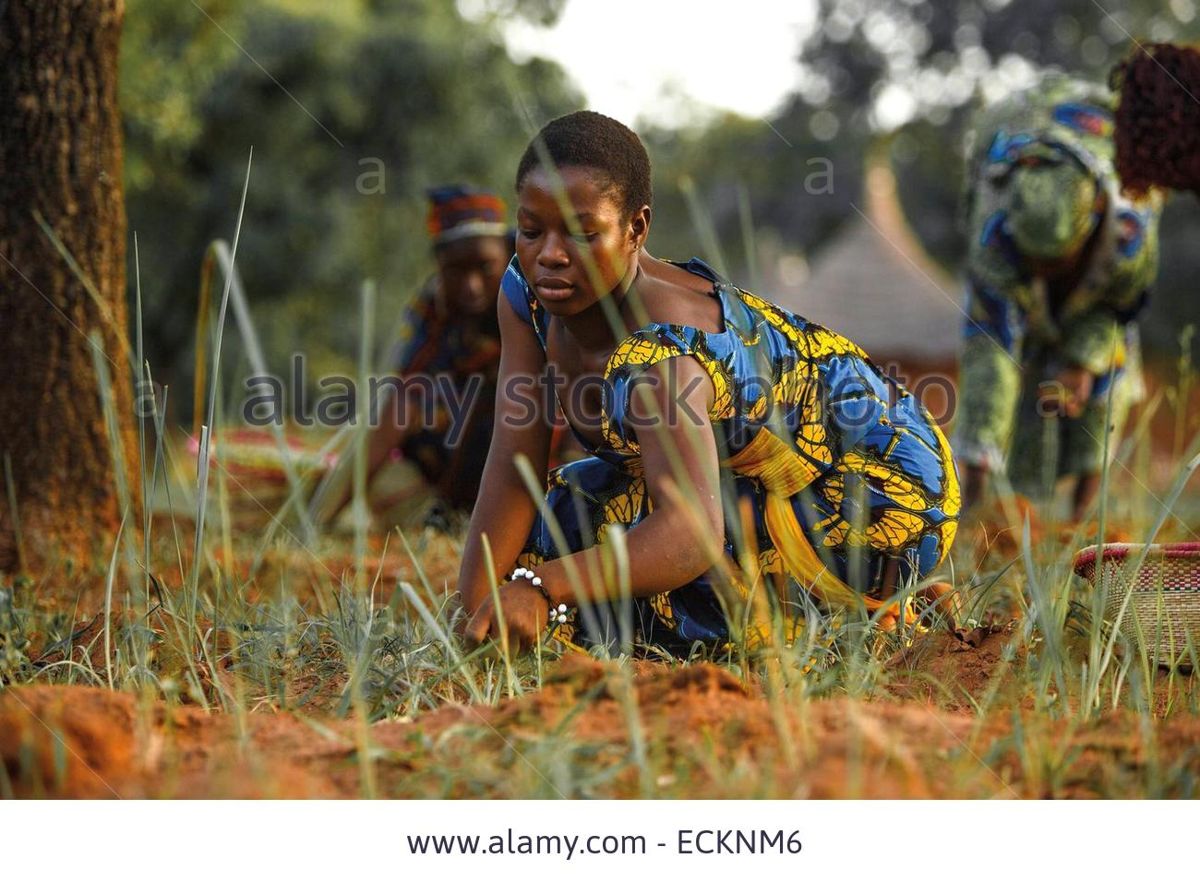
Khassonké

Slide 13
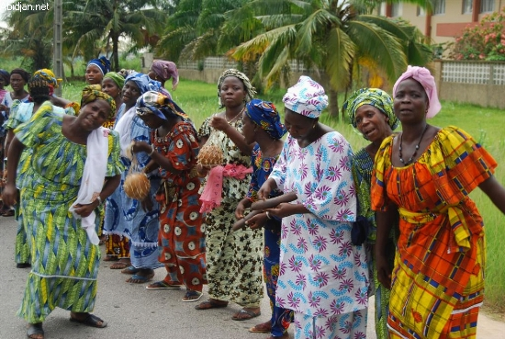
Sarakollé or Soninké

Slide 14
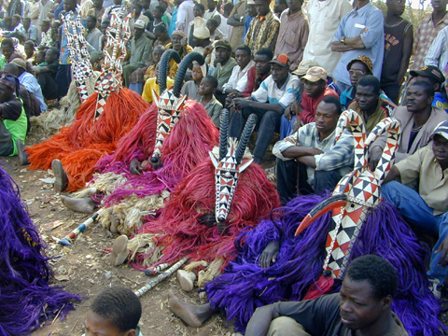
Bobo

Slide 15
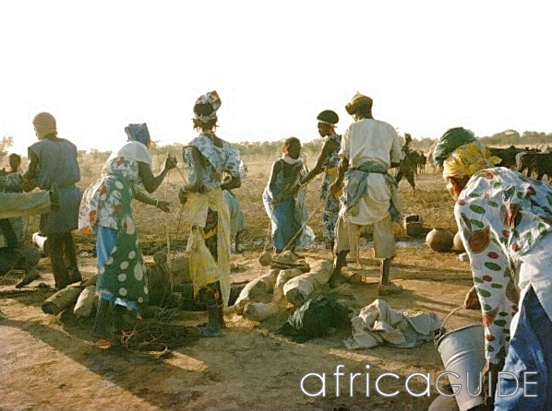
Les Peuls ou Fulani

Slide 16
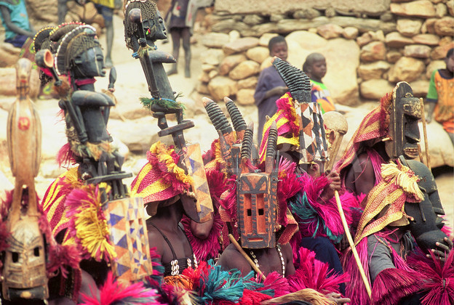
Dogon

Slide 17
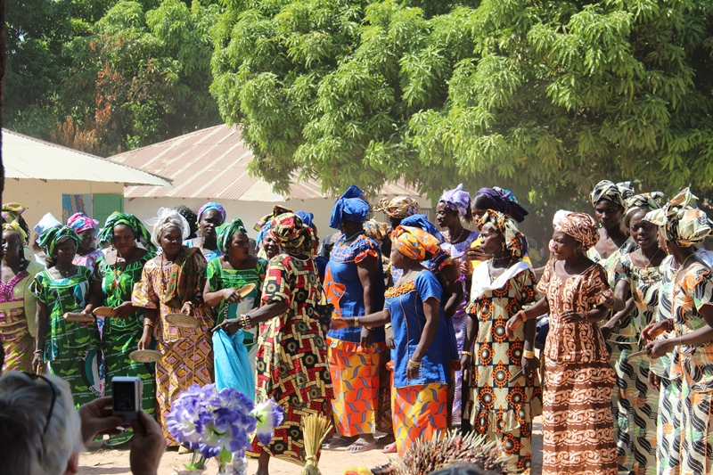
Minianka

Slide 18
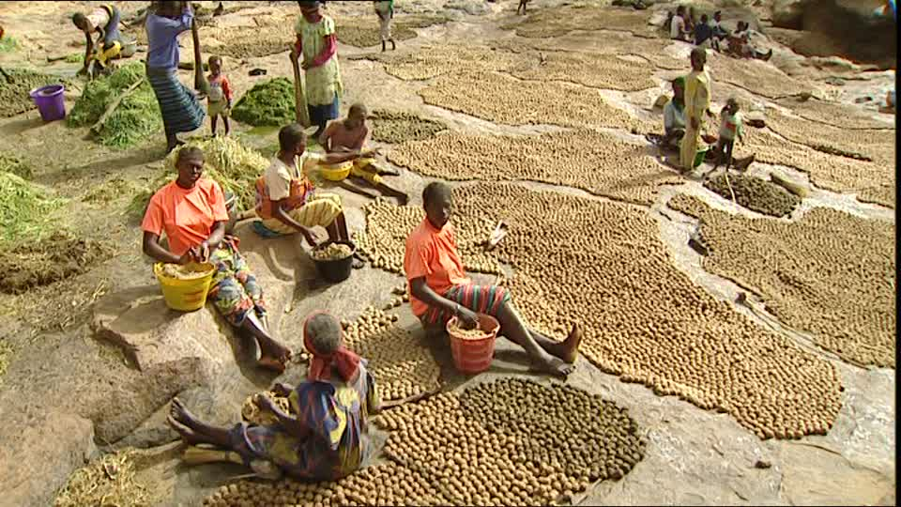
Sénufo

Slide 19
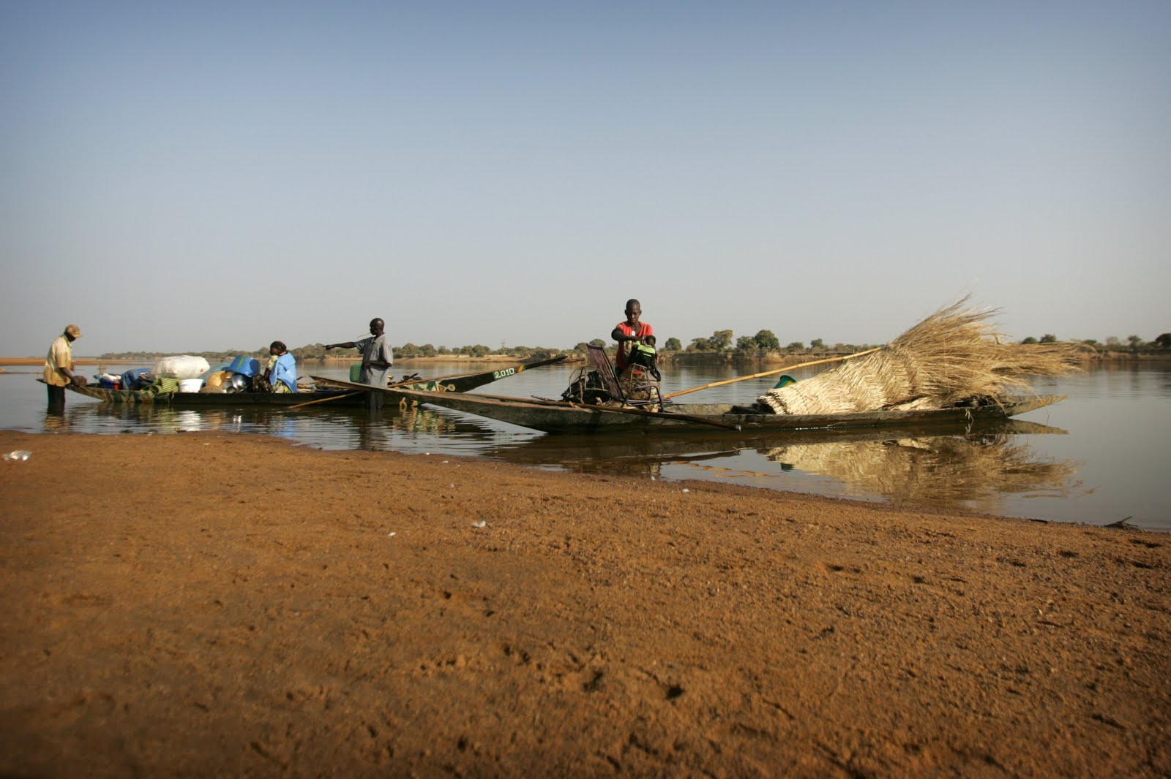
Bozo/Somono

Slide 20
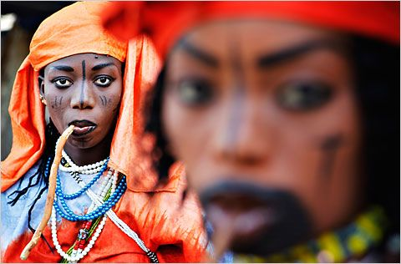
Toucouleur

Slide 21
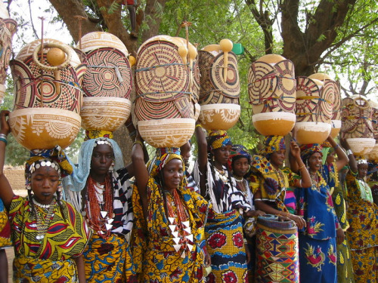
Sonrhai (Songhai)

Slide 22
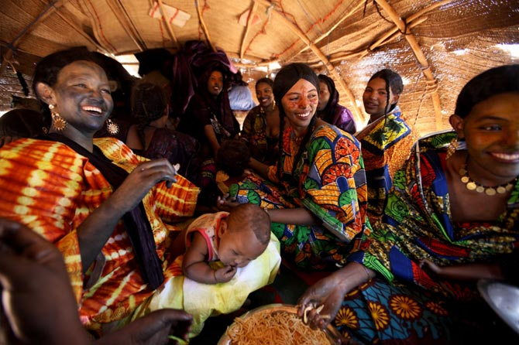
Tuareg

Slide 23
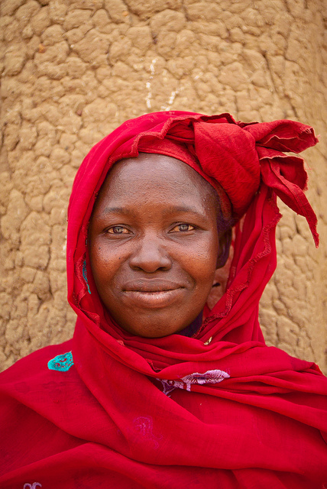
Ethnic groups in The Most Vulnerable
Bambera

Slide 24
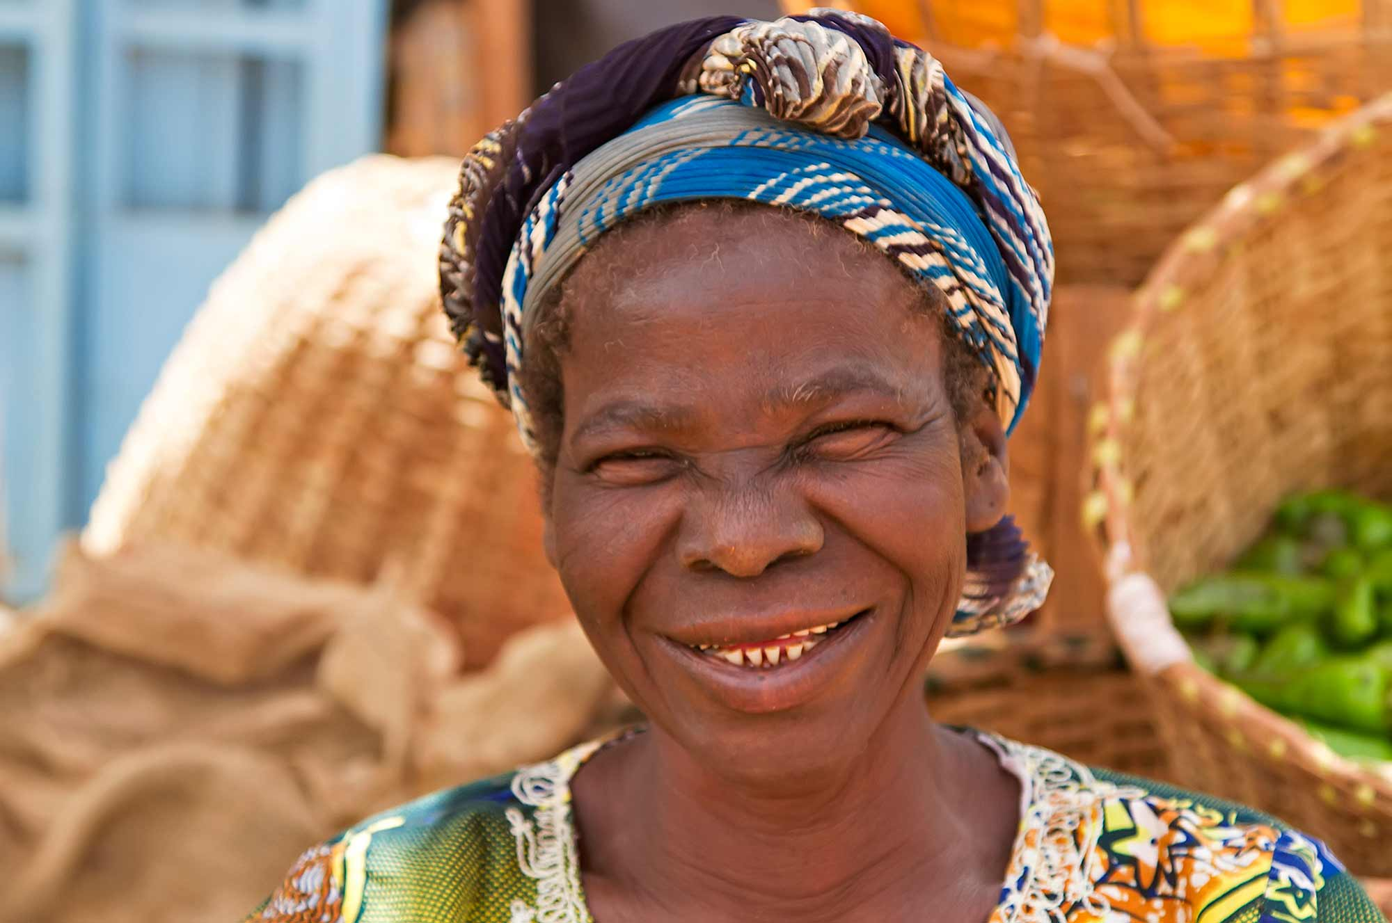
Bobo

Slide 25
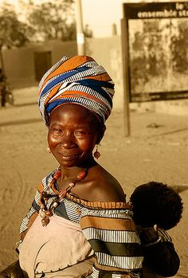
Dogon

Slide 26
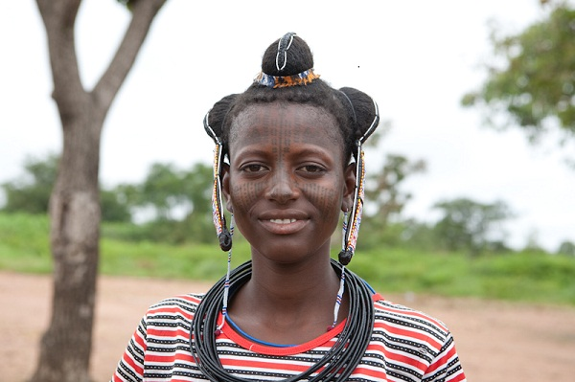
Fulani

Slide 27
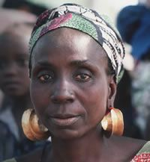
Malinke

Slide 28
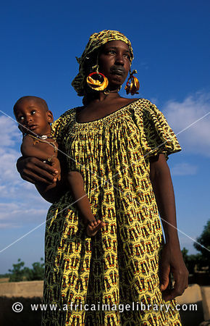
Minianka

Slide 29
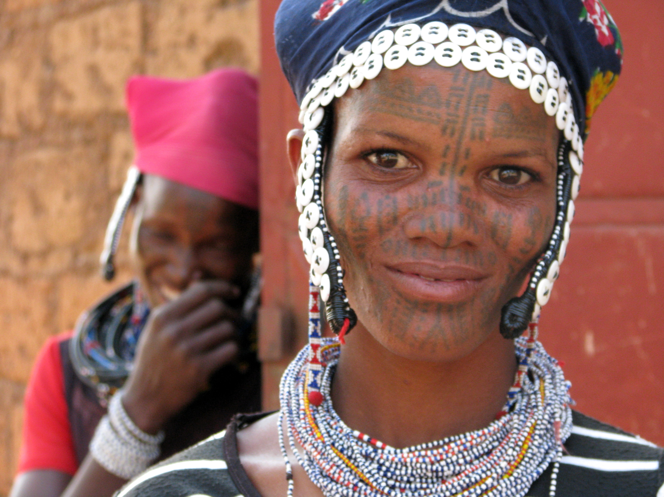
Peul

Slide 30
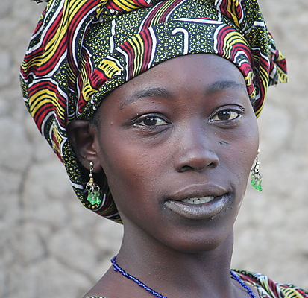
Samogo

Slide 31
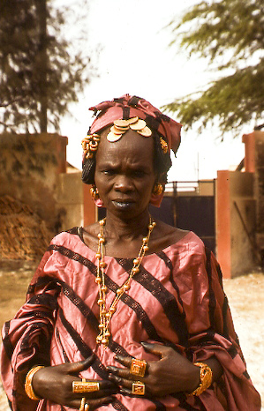
Sarakole

Slide 32
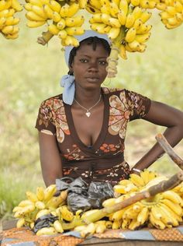
Senufo

Slide 33
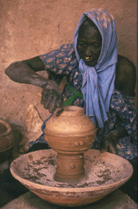
Somono (Bozo)

Slide 34
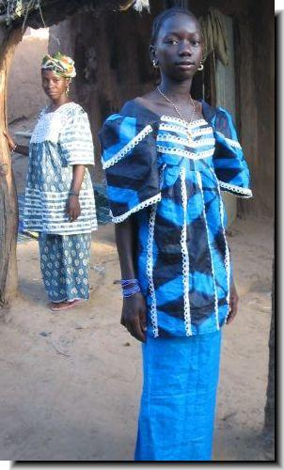
Soninke

Slide 35
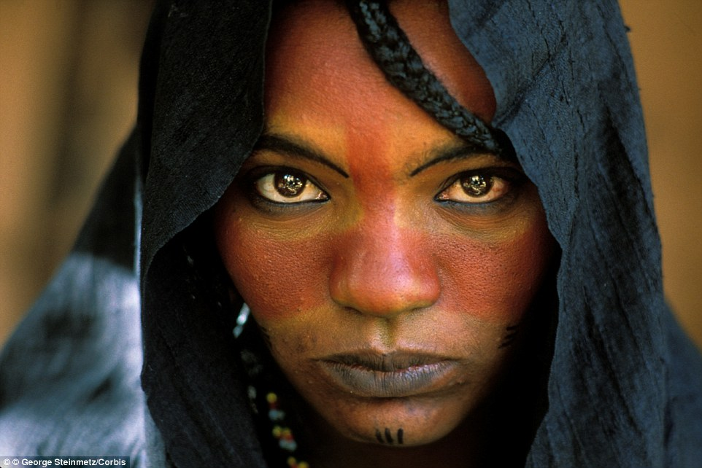
Tuareg

Slide 36
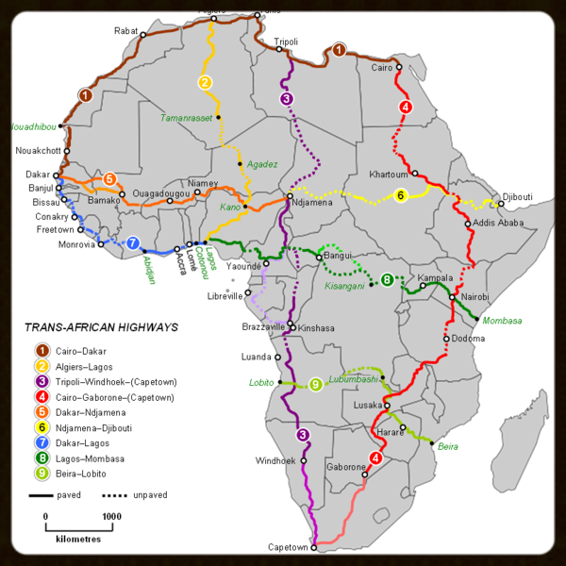
The Trans-African Highway trucking routes

Slide 37
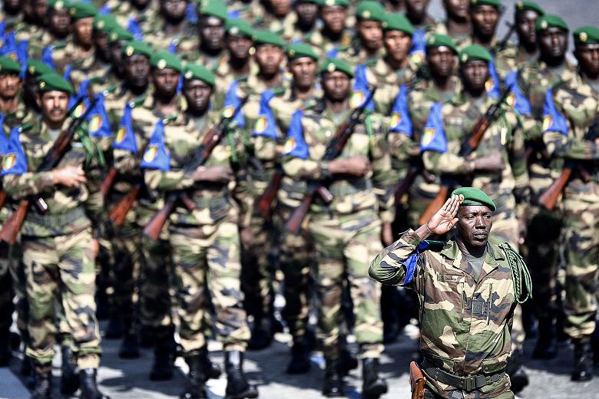
Malian Army

Slide 38
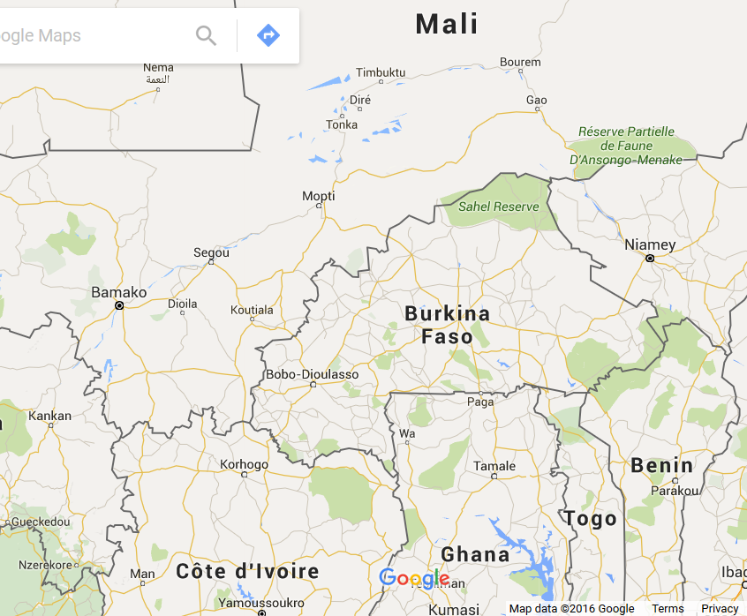

Slide 39
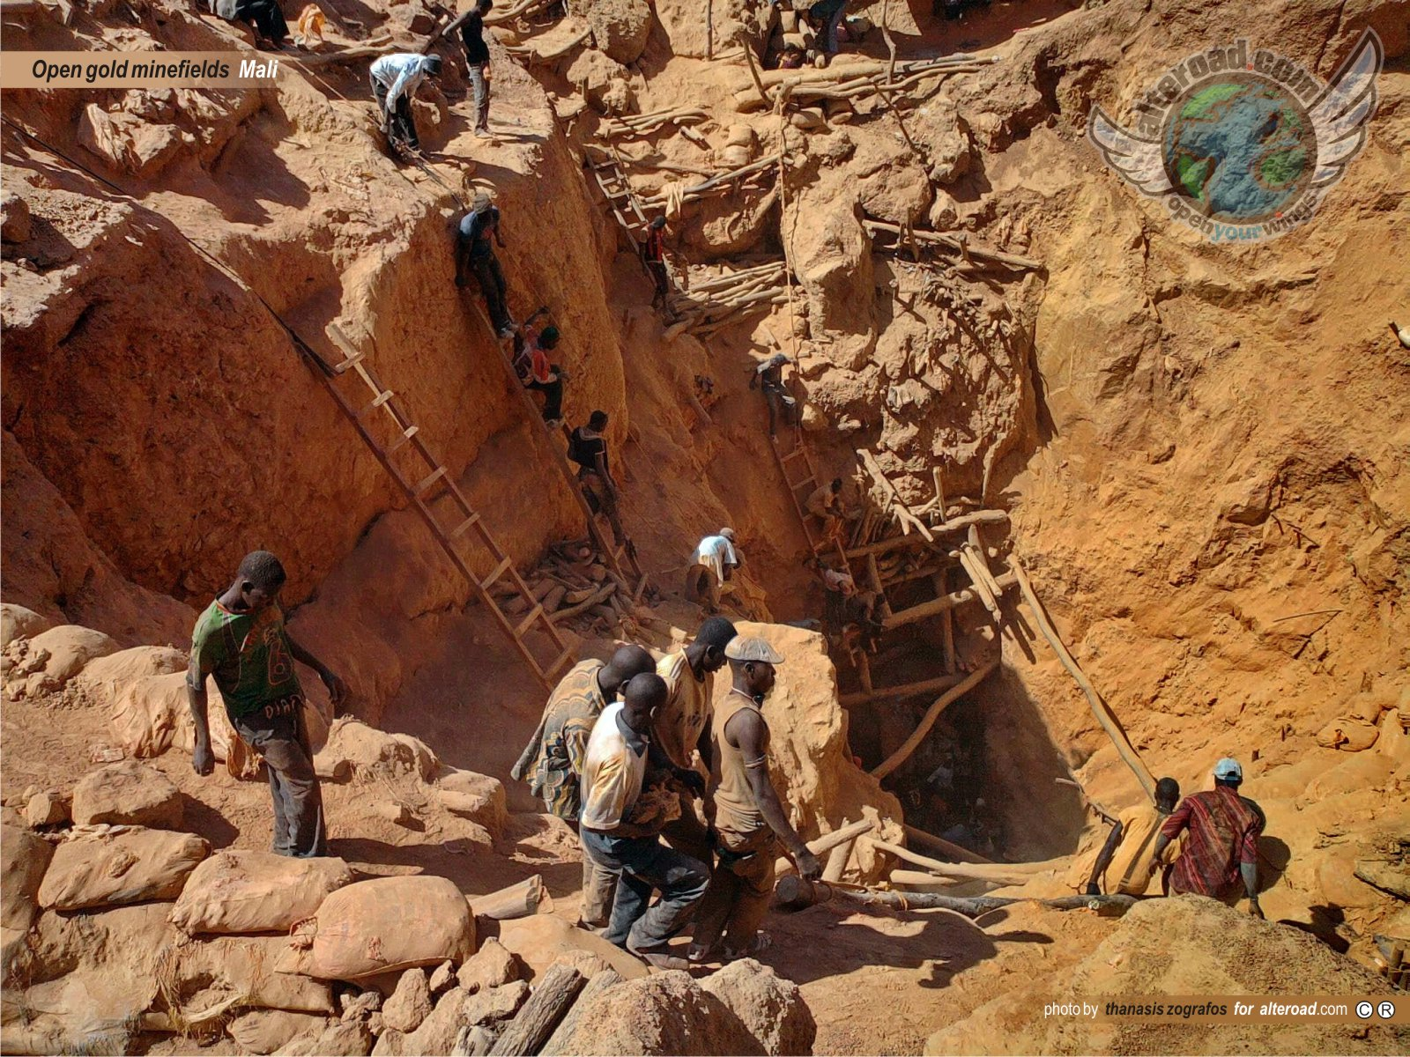
Gold mines in Mali

Slide 40
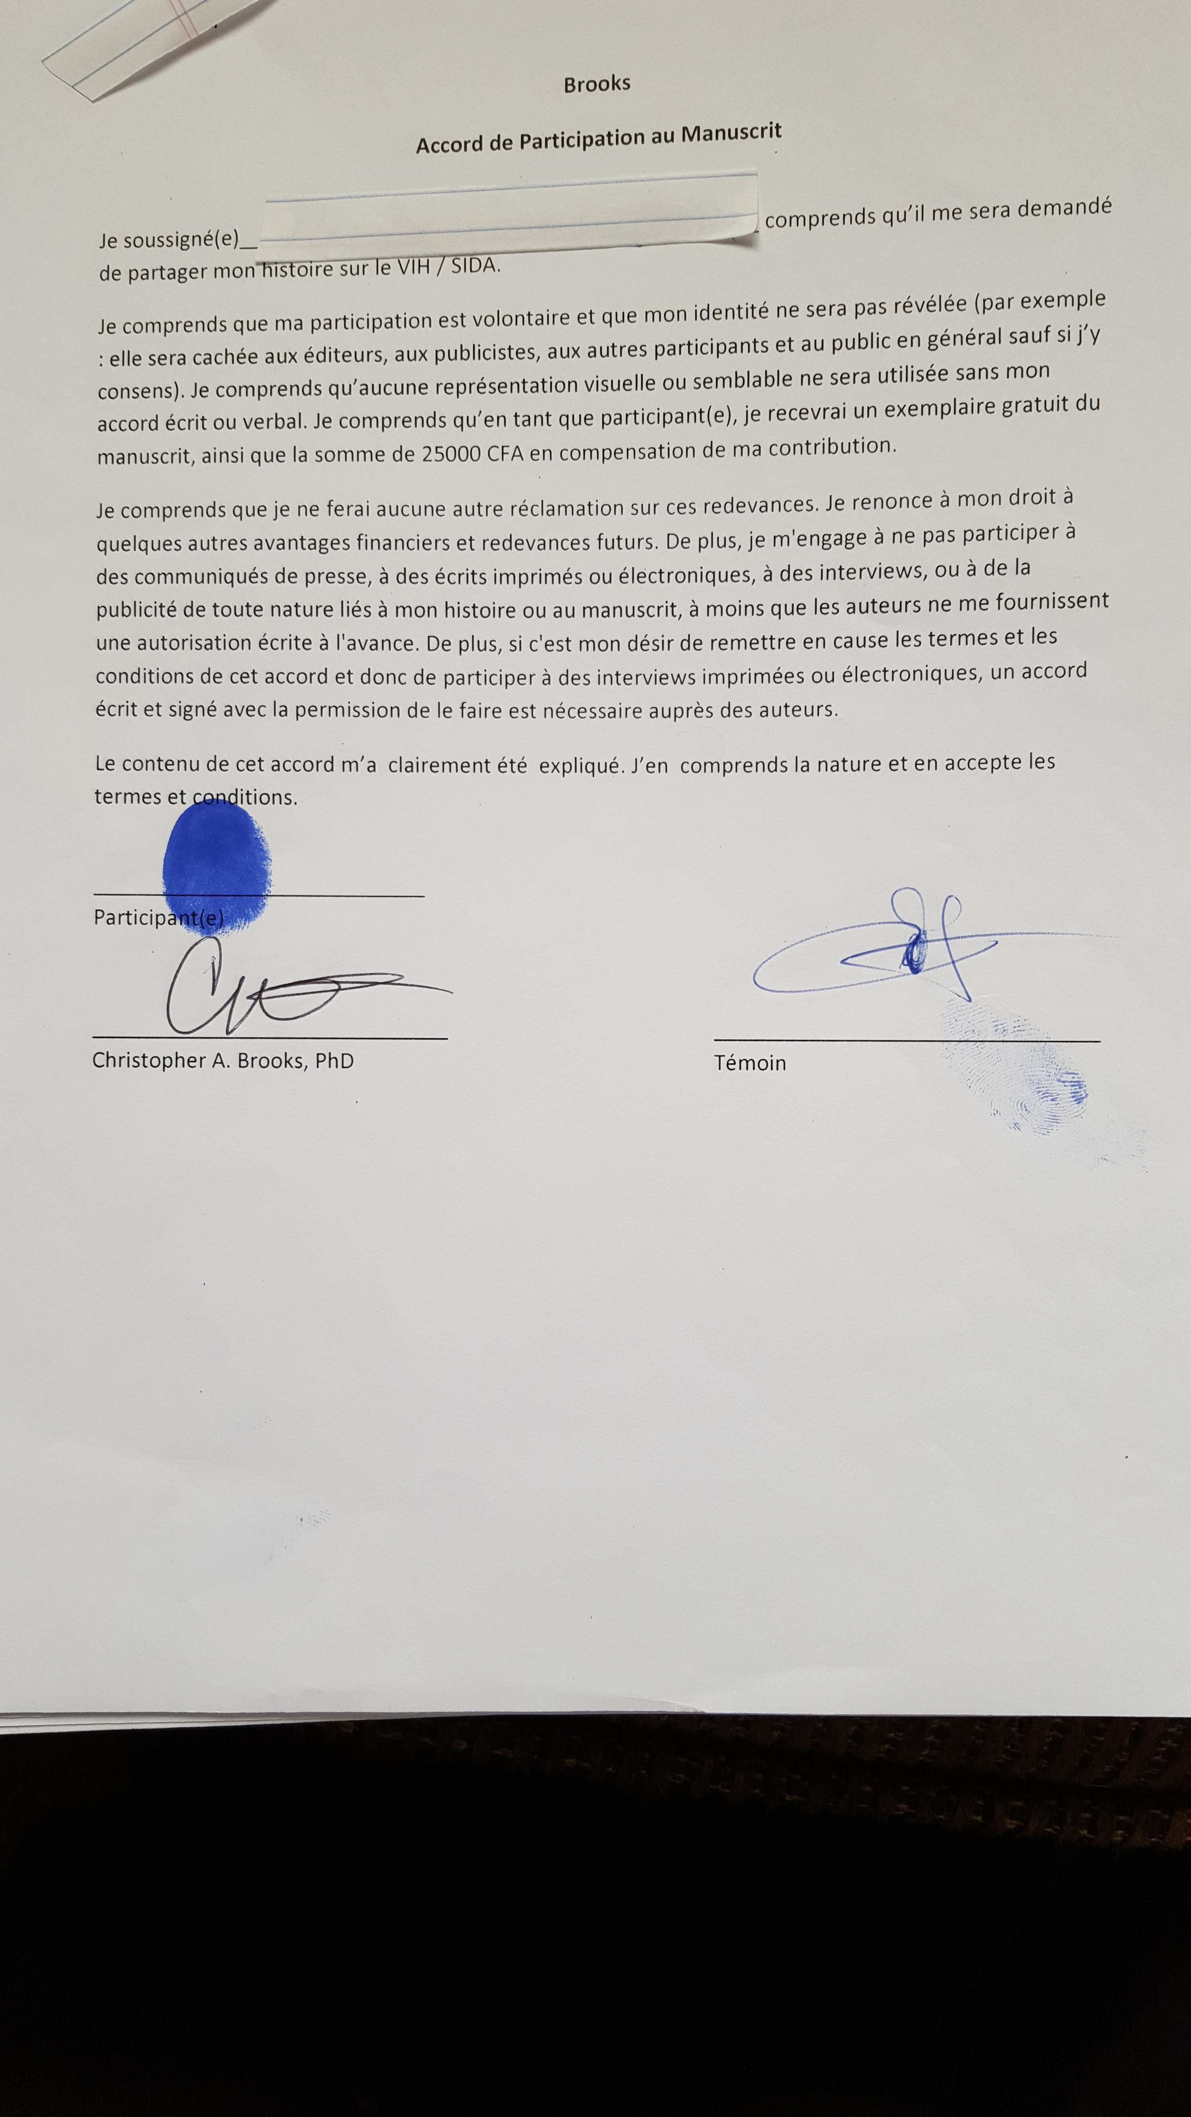
Brooks consent form

Slide 41
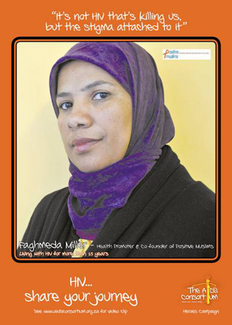
Positive Muslims In South Africa

Slide 42
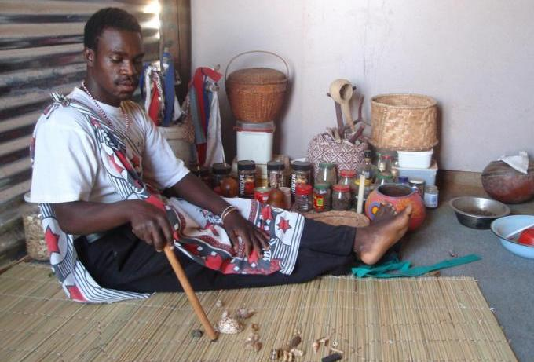
Traditional Healers in Mali

Slide 43
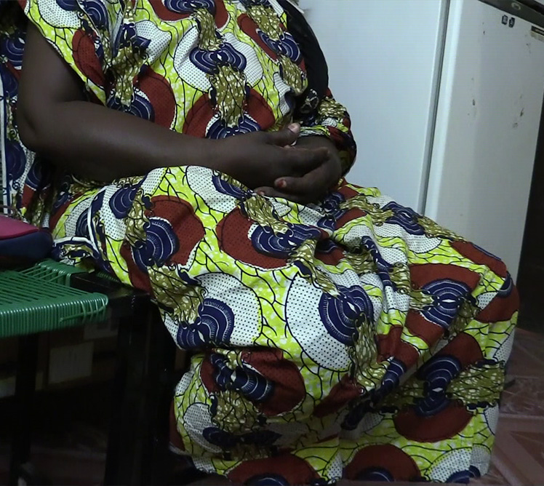
Mariatou Dembele

Slide 44
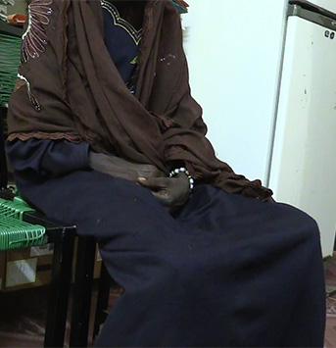
Oumou Ouattara

Slide 45
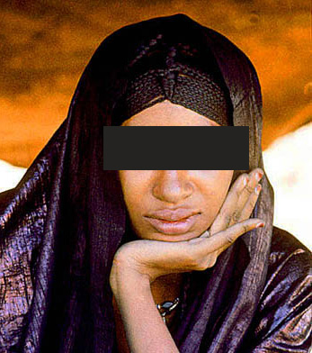
Fatimata Musa

Slide 46
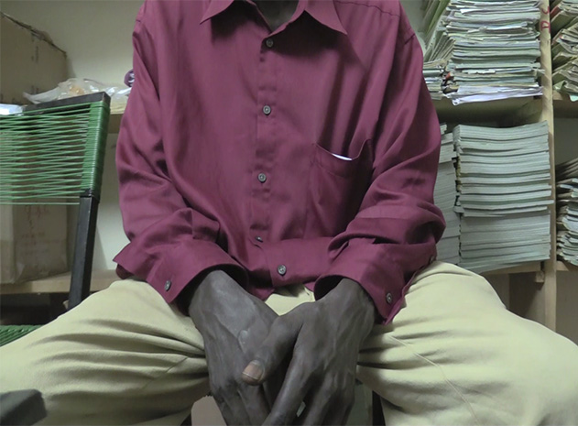

Slide 47
Acknowledgements
Bill and Melinda Gates Foundation
US Department of Education Title VII
VCU Anthropology
VCU Humanities Center
College of Humanities and Sciences
VCU Women’s Health Institute,
VCU HIV/AIDS Center
Virginia Friends of Mali
City of Segou
Charlotte Russell, Intern
HIV in Africa course members
David G. Kimani - Presentation

Slide 48
The End
Thank you!!

